Slide 1
FISH 552 Introduction to R Programming
Kristin Privitera-Johnson
kpjohns@uw.edu

Slide 2
Introduction
Course website
https://canvas.uw.edu/courses/1320540
Syllabus
First 10 lectures, Introduction to R, FISH 552
Followed immediately by 10 lectures, Advanced R, FISH 553
Meet your TA: Thiago Couto
This is a bullet point to remind me to introduce myself.

Slide 3
Kristin, open FISH 552 Attendance.R

Slide 4
Course structure
Lectures
Posted on canvas the night before
https://canvas.uw.edu/courses/1320540
Sequence: Review, in-class activities, 10 min break; lecture, in-class activities
Four assignments:
Due Fridays by 11:59 pm
11 October, 18 October, 25 October, and 1 November
Hand in R code with solutions to Canvas website
Course is credit/no credit
Credit awarded for completion of course activities, contributing to online discussion boards, and completion of assignments.

Slide 5
Classroom Culture and Norms
Groups of 3
One person from each group pull up: PollEv.com/fish552
Distribute red/green flags

Slide 6
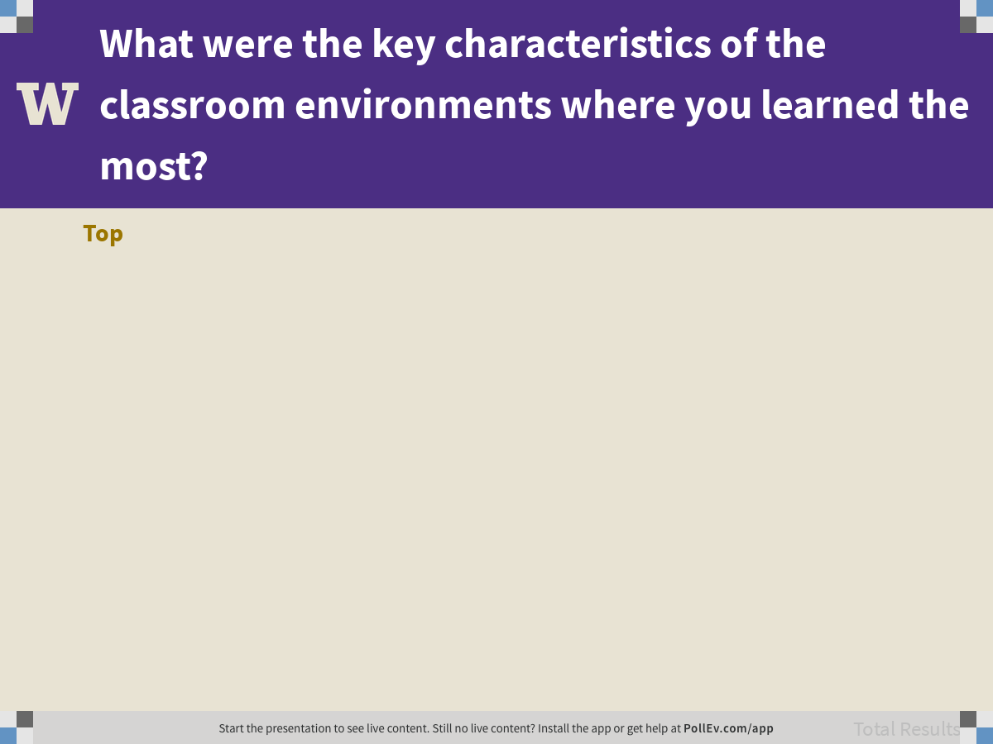
Notes:
Poll Title: What were the key characteristics of the classroom environments where you learned the most? https://www.polleverywhere.com/discourses/QLez2sCcJHmcbqHrBLL5f

Slide 7
Break – Take care of yourself
Next time you’re sitting at a computer, do a posture check to see how you position yourself. If you notice some of the behaviors listed below, repeat the posture check every 15 minutes while correcting those habits.
Shoulders, head, and hands:
Are your shoulders both rounded over toward your computer?
Are they hiked up to your ears?
Do you dip one shoulder forward?
Lean on an elbow?
Is your head protruding forward?
Are your fingertips higher than your wrists?
Legs, hips, and feet:
Are both feet flat on the ground?
Do you sit on the edge of your seat or back with your feet up?
Are your legs crossed?
Do you turn one hip in toward the desk and open the other out to the side?
https://counseling.northwestern.edu/blog/Self-Care-Solutions-Body-At-Computer/

Slide 8
Recommended reading
An introduction to R (Venables et al.)
http://cran.r-project.org/doc/manuals/R-intro.pdf
Chapters 1, 2, 5.1-5.4
YARI—yet another R introduction (Handel)
http://ahandel.myweb.uga.edu/software/yari.pdf
Sections 3.1, 3.2, 4.1, 4.3, 5.1, 5.2, 5.5
R reference card (Tom Short)
https://cran.r-project.org/doc/contrib/Short-refcard.pdf
Pro-tip: tape up within view of your desk
Getting started with R: an introduction for biologists (Beckerman & Petchey)

Slide 9

What is R?
R is a computer language, an environment for statistical computing & graphics, and much more
Open source (free), cross platform, easily extendable (via packages)
It is script-based (text computer code) and not GUI-based (point and click with menus)
R is not perfect or “better” than other languages, but it is popular and mainly for two reasons:
Statistical capabilities
Community inertia

Slide 10
What is R
It also has a large and highly flexible collection of graphing facilities for data display
Branch et al. (2010) Nature 468:431-435

Slide 11

R is not:
Pirate eye-chart
Easy to use: there is a learning curve
Consistently written: it is pieced together from many authors
Fast, compared to C++ or Python
Easy to debug... but recently improved
Posted by @utterben on Twitter

Slide 12
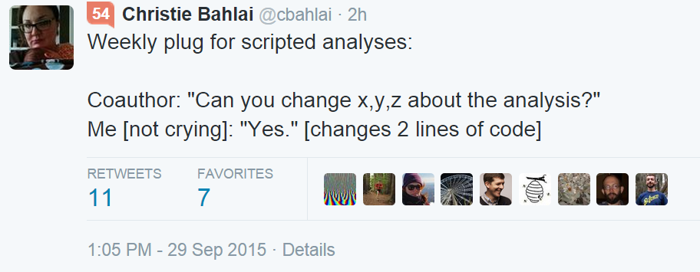
Rule of thumb: every analysis you do on a dataset will have to be redone 10–15 times before publication. Plan accordingly.

Slide 13
Common uses of R by scientists
Explore data via summaries, plots or classical statistical analyses: ANOVA, LM, GLM, …
Advanced analyses: Bayesian inference, random forests, spatial, mixed effects, … (via packages)
Publication quality figures
Larger projects (e.g. publication): functions, scripts, documentation, reproducibility
Build your own R package and share via github.com

Slide 14
Learning R
R is a programming language, the learning curve can be steep so be patient
Like human languages, what you get out is what you put in
Increased productivity when fluent
Many sources of help: online, books, labmates, etc.
Course readings
Books: R graphics (Murrell), The R book (Crawley), A Primer of Ecology with R (Stevens)
R reference card 2.0 (Baggott)

Slide 15
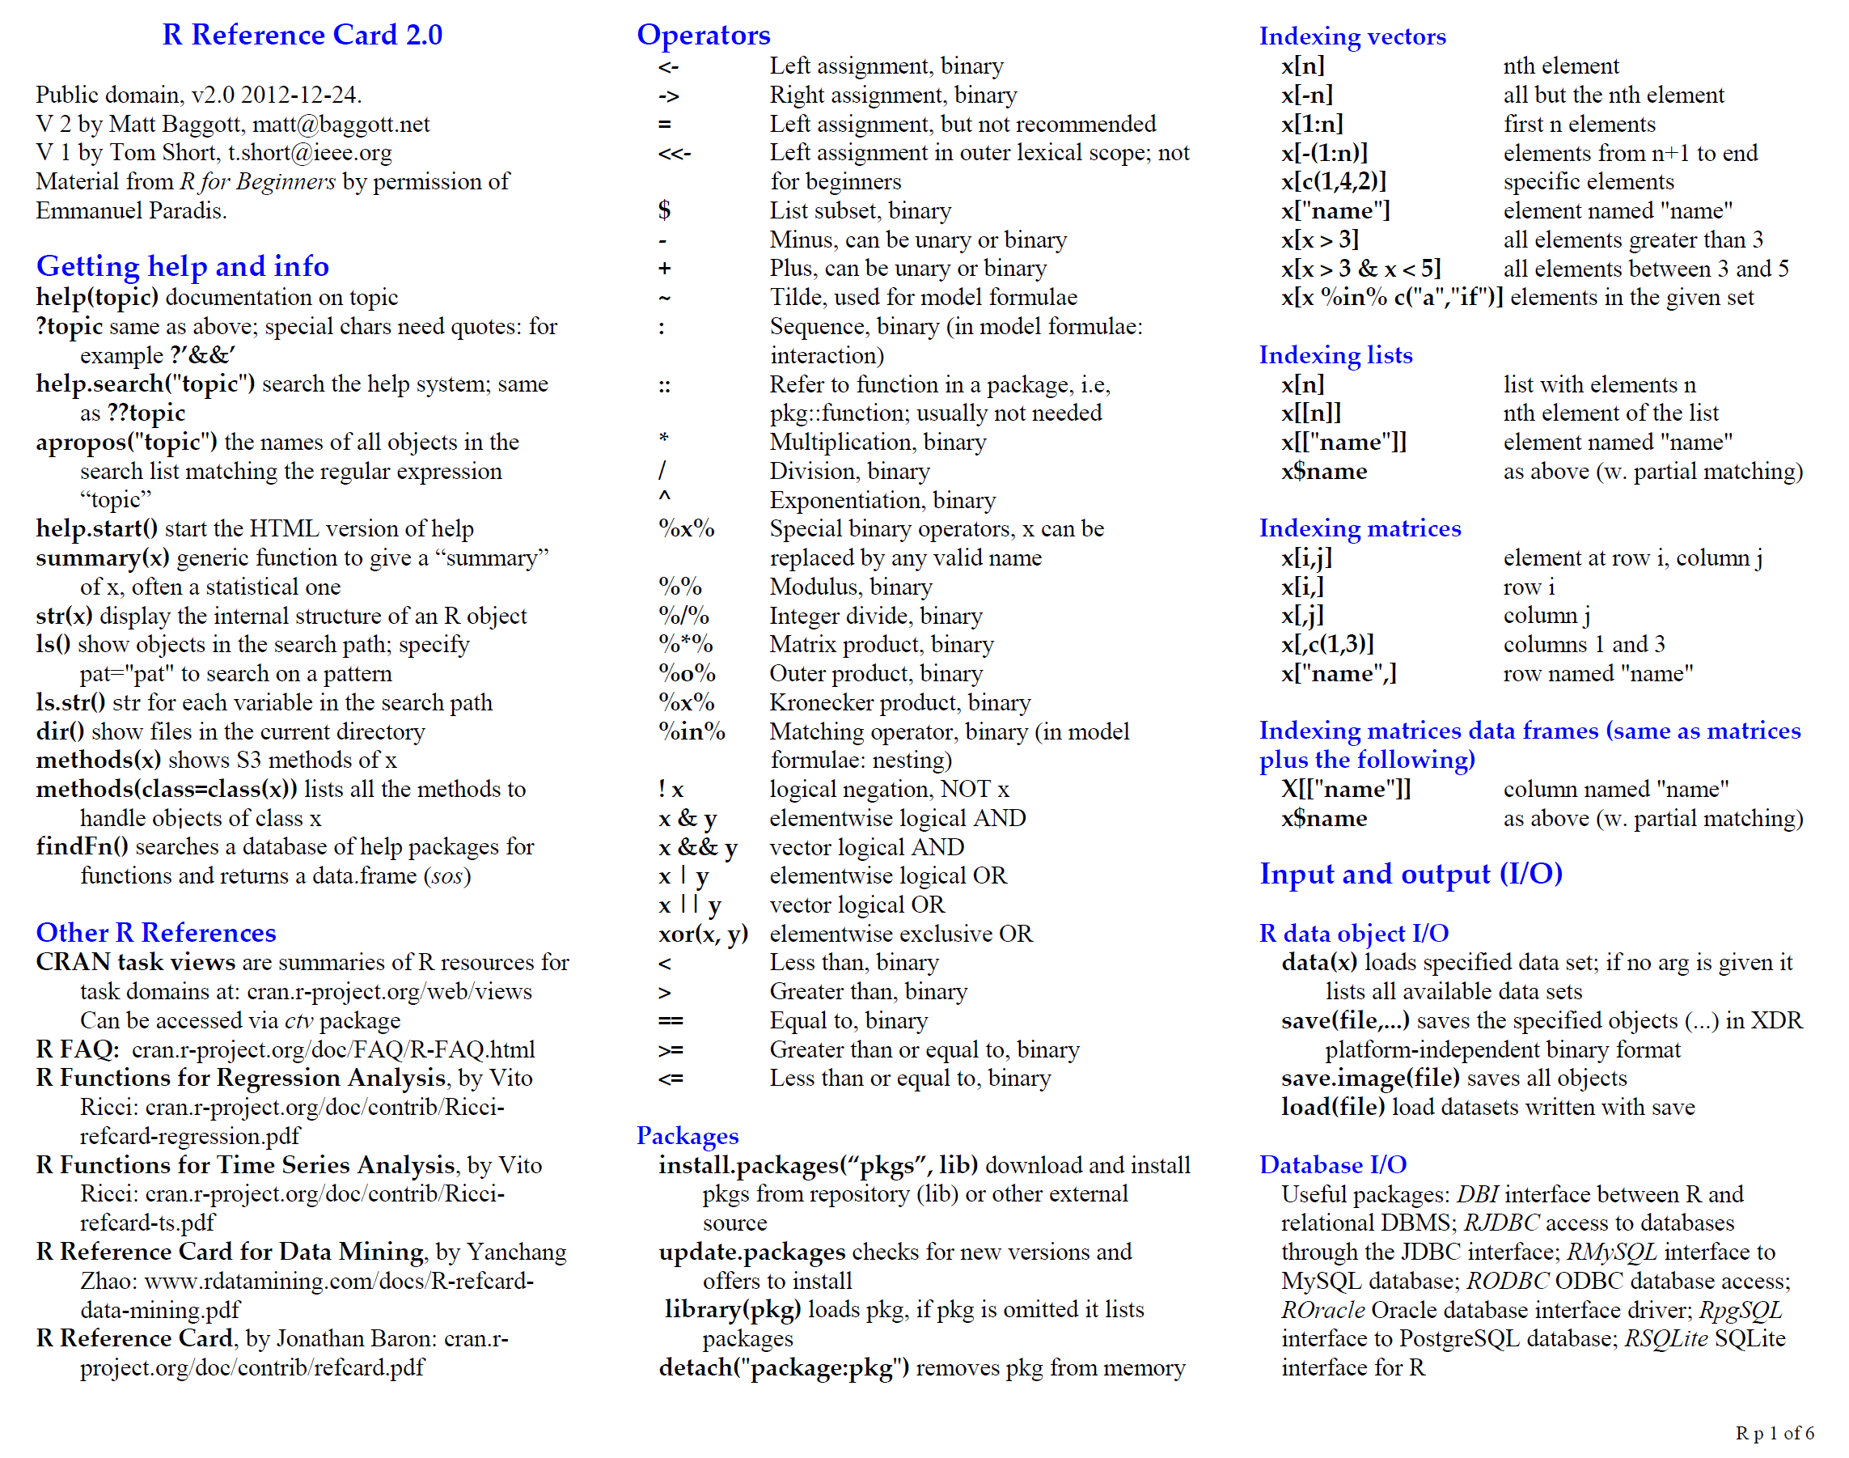

Slide 16
Online reference material
The R project website
http://www.r-project.org/
R seek (specific R search engine)
http://www.rseek.org/
Google it… “r” returns R
Very often someone else has had the same problem

Slide 17
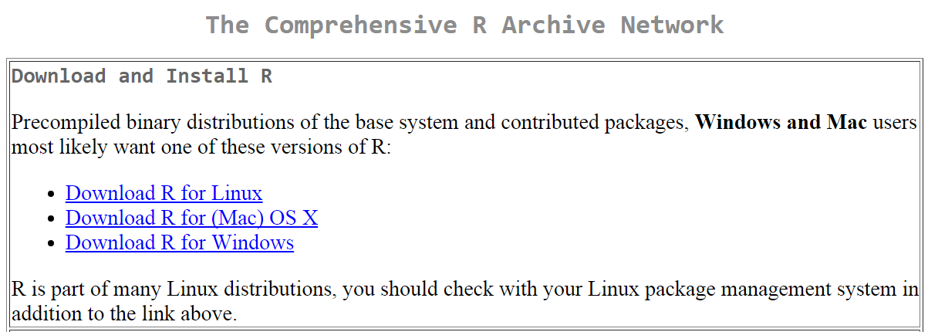
Where to get R
The program can be downloaded from one of the official mirrors of CRAN
http://cran.r-project.org/
Download the appropriate compiled binary code for your operating system

Slide 18
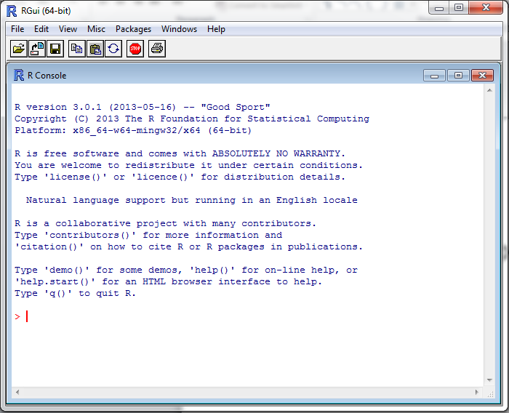

Load up R
Find the standalone R program
Open it
Enter commands at the > sign, e.g.
> 2 + 4
> x <- 7
> x + 19
The > is the R
command prompt
This font means this is an R command

Slide 19
What is R doing?
The [1] means the first element of a vector
Even a single number in R is a vector, so “6” is a vector of size 1
> 2+4
[1] 6
> x <- 7
> x + 19
[1] 26
> X + 10
Error: object 'X' not found
<- means “assign” in this case “assign the value 7 to the variable x”
Some use = for this purpose but it is frowned upon
Adding 19 to x gives the expected value of 26
X is not the same as x
R is case sensitive: upper case letters are different to lower case letters

Slide 20
RStudio
It is tedious to write R code in the command line, and your code is not saved nor reproducible
Much better: use RStudio. Why?
Multiple files
View variable values, color coding
Built-in help
Quick running of code
Easy file handling
Easy package installation
Many other reasons
There are other editors, e.g. Vim, Emacs, Sublime Text, TextPad... but Rstudio is easiest.

Slide 21
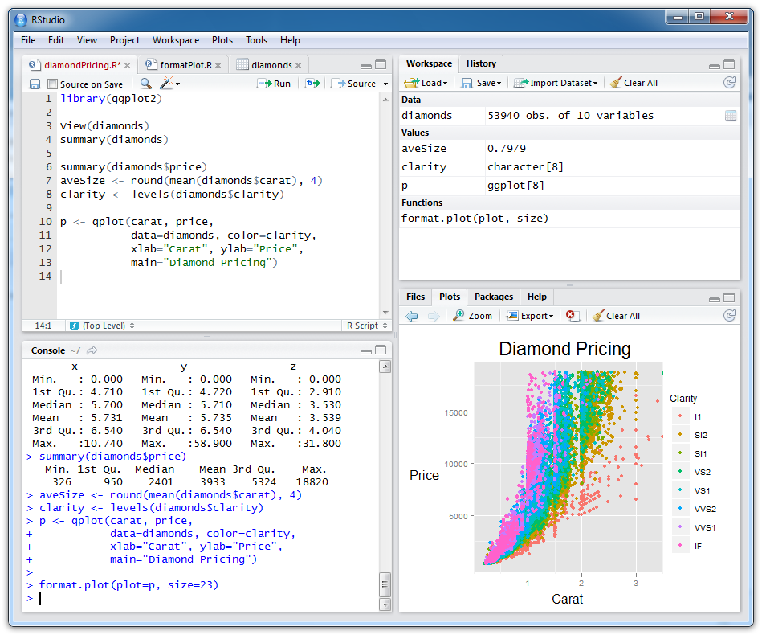
Scripts (files
with R code)
Objects you have created
Plots and help
R console (results from
running R code)

Slide 22
R scripts
A text file (e.g. lab1.r) that contains your R code for one complete analysis
Scientific method: complete record of your analysis
Reproducible: rerunning your code is easy for you or someone else
Easily modified and rerun
In RStudio, select code and type <ctrl+enter> to run the code in the R console
SAVE YOUR SCRIPTS

Slide 23
Help from within R
Getting help for a function
> help("log")
> ?log
Searching across packages
> help.search("logarithm")
Finding all functions of a particular type
> apropos("log")
[7] "SSlogis" "as.data.frame.logical" "as.logical" "as.logical.factor" "dlogis" "is.logical"
[13] "log" "log10" "log1p" "log2" "logLik" "logb"
[19] "logical" "loglin" "plogis" "print.logLik" "qlogis" "rlogis"

Slide 24
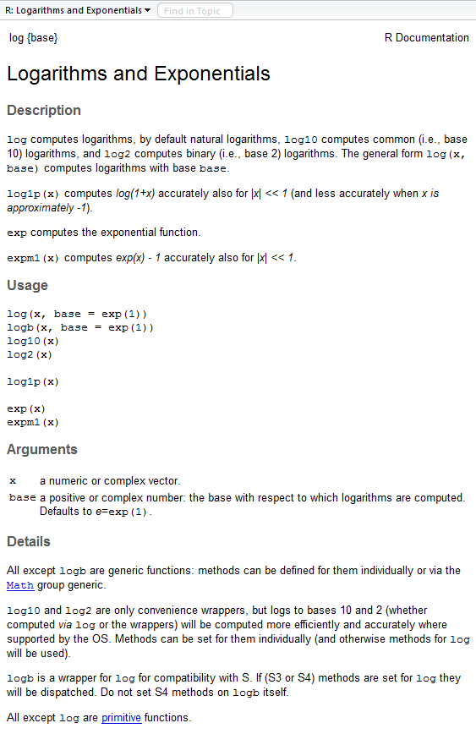
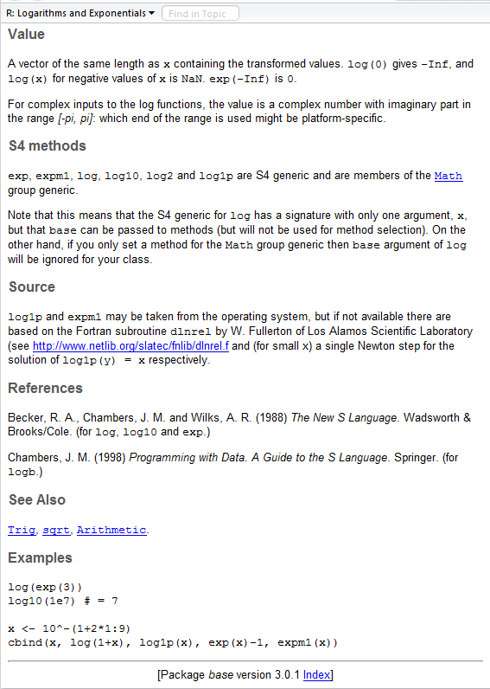
?log
What does the function return
What the function does in general terms
How to use the function
What does the function need
Discover other related functions
Sample code showing how it works

Slide 25
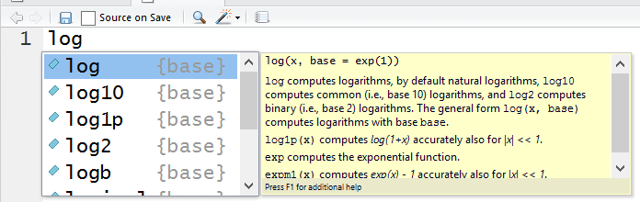
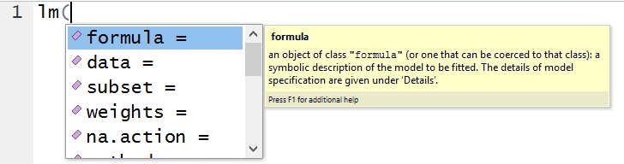
RStudio quick help
Start typing log in the Scripts window (top-left) and a list of available functions starting with those letters appears, plus help
S
S
S
S
Try typing lm( and then <Tab> for the arguments of the lm() function

Slide 26
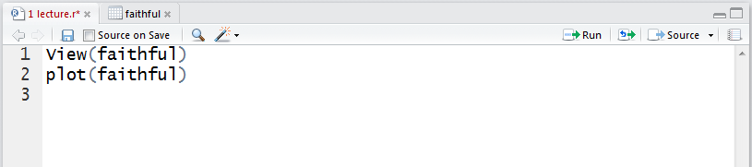
RStudio tips
Sends current line or selection to console (faster to type ctrl+enter or ctrl-r)
Sends entire file to console
Re-send the lines of code you last ran to the console
(useful after edits)

Slide 27
Commenting your code (do it)
Use “comments” to document the intention of your code
Anything on a line after # is ignored by R
# Old Faithful geyser, Yellowstone NP
plot(faithful)
Rules of thumb
Document the purpose of the code not how it works
Use good variable names
Document for your future self: you will remember nothing about the code when you look at it next week or year
RStudio: different color for comments

Slide 28
Some simple R commands
> 2+2
[1] 4
> 3^2
[1] 9
> sqrt(25)
[1] 5
> 2*(1+1)
[1] 4
> 2*1+1
[1] 3
> exp(1)
[1] 2.718282
> log(2.718282)
[1] 1
> log(10, base=10)
[1] 1
> log(10
+ , base = 10)
[1] 1
Result of the command
Optional argument
Order of precedence
Incomplete command

Slide 29
R workspaces
When you close RStudio, SAVE YOUR .R SCRIPT
You can also save data and variables in an R workspace, but this is generally not recommended
Exception: working with an enormous dataset
Better to start with a clean, empty workspace so that past analyses don’t interfere with current analyses
rm(list = ls()) clears out your workspace
Should be able to reproduce everything from your R script, so save your R script, don’t save your workspace

